Slide 1
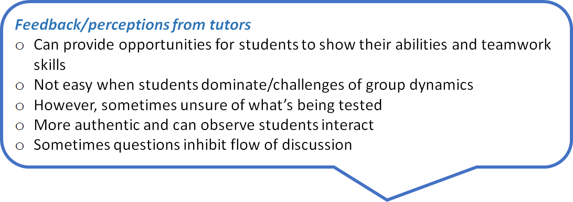
Assessed Seminars for pre-sessional international post-graduate management students Siriol Lewis and Vanessa McDonagh, English for Academic Study, University of Glasgow
Context: 5 weeks pre-sessional international bridging programme for Master in Management
Number of Students: 150-200, predominantly Chinese
Assessment: original speaking skills - individual student presentations on an aspect of a company’s management, for example, marketing or operations management -> small group seminar discussions
Rationale for change in 2015:
1. Presentations did not reflect the current assessment in the degree courses, where students had to participate in seminars, and
2. feedback from faculty staff concerning students’ reluctance to participate in academic discussions.
Assessment Criteria
Development of content | Use of language | Interactive skills
Discussed relevant ideas | pronunciation | Voice (projection, pace, clarity)
Developed/explained ideas | Accuracy grammar/ vocabulary | Body language (eye contact, gestures, movement)
Referred to reading/lectures | Range grammar/ vocabulary | Effective, appropriate turn-taking
Showed stance | fluency | Added to other speakers’ ideas
 |  | Checked/clarified meaning
 |  | Agreed/challenged appropriately
 |  | Listened responsively
Challenges
Diverse task features affects fluency, complexity, accuracy (Skehan 2001, cited in Wrigglesworth, 2008).
High level/range of metacognitive skills required
Dynamics could impact performance.
Group size may impact on an introverted individual’s performance. (Nakatsuhara, 2011).
Construct irrelevance variance: Reliance on reading skills and listening skills to understand input, yet speaking skill is assessed.
Pragmatics may be problematic – understanding and interpreting cues
Parity of marking across 16 classes.
Assessing content can be problematic. Bridging course, focus on language input and content; tutors are not trained to assess content (although the content and its analysis is mainly at a surface level).
Halo effect, where the grading of one criterion influences all others, resulting in a flat profile (Thorndike, 1920).
Strong forms and weak forms proved to be problematic, as many language tutors are more comfortable with ‘weak form (section 2, Table 1)
What are we assessing?
Who is assessing what?
How do tutors assess content?
Is there a difference between tutors with experience of assessing academic seminars and tutors who are new to this genre?
Task-based Learning Assessment
TBL is a classroom exercise in which L2 is used to complete authentic exercises, ‘goal oriented, content focused, real outcome, reflects identified target language’. (Shehadeh, 2012)
Two complementary approaches characterise TBLA:
construct-centred approach which tests linguistic proficiency
work-sample approach, which is the development of content and interactive skills (Shehadeh, 2012).
McNamara (1996) defines two forms of assessment ‘Strong’ assessment is the use of language as the mode to achieve the task – effective seminar participation.
In contrast, in the 'weak' form, language is assessed rather than the actual task.
In a HE context, both strong and weak forms of assessment exist. In the preliminary stages of a longer pre-sessional course, the focus would be on the weak form. However, in high stakes bridging course exit tests the emphasis is frequently on the strong form relating to section 1 of the criteria (Table 1).
Table 1
Innovative Assessment:
Task-based performance language assessment
Replicating MSc seminars – entry to 'communities of practice' (Lave and Wenger, 1991)
Future research
At a higher level, ‘the extent to which inferences can be made from the language elicited by particular tests tasks as a reflection of the candidates' ability to manage the task in a subsequent real world context is not fully resolved.’ (Wrigglesworth, 2008 , p.117) Thus at a local level, it would be valuable to track students’ performance in seminars in faculty to discover if there is any correlation between programme performance and degree performance. It also would be worthwhile conducting quantitative and qualitative research with MSc students to ascertain their perceptions of the value of task-based performance testing on a bridging course.
Preparation Practice seminar on another topic, based on jigsaw reading (texts distributed some days prior) Video lecture on the assessment topic with scaffolded notes (link available to the students for reviewing purposes) Practice discussion with two cross-referenced texts on the assessment topic + guide questions Two further cross-referenced texts + guide questions 4 days prior to the assessment Students may bring notes only to the assessed seminar. Groups of 6 are formed from the same class – students have been together for 5 weeks. Both the class tutor and the lecturer are present to ensure rater reliability. The class tutor may initiate discussion but should withdraw after a few minutes.
References:
Aguilar, M. (2016). Seminars. In K. Hyland and P. Shaw (Eds.), The Routledge Handbook of English for Academic Purposes (pp.335-347). London: Routledge.
Engin, M. (2017). Contributions and silence in academic talk: Exploring learner experiences of dialogic interaction. Learning, Culture and Social Interaction, 12, 78-86.
Lave, J. and Wenger, E. (1991). Situated learning: legitimate peripheral participation. Cambridge: Cambridge University Press.
McNamara, T. (1996). Measuring Second Language Performance. London: Longman.
Nakatsuhara, F. (2011). Effects of test-taker characteristics. Language Testing 28(4), 483-508.
Shehadeh, A. (2012). Task-based Language Assessment: Components, Development, and Implementation. In C. Coombe, P. Davidson and B. O’Sullivan (Eds.), The Cambridge Guide to Second Language Assessment (pp. 156-163). Cambridge: Cambridge University Press.
Thorndike, E. L. (1920). A constant error in psychological ratings. Journal of Applied Psychology, 4, 469-477.
Wrigglesworth, G. (2008). Task and performance based assessment In E. Shohamy and N. H. Hornberger (Eds.), Encylopedia of Language and Education, 2nd ed, volume 7: Language Testing and Assessment (pp.111-122). Switzerland: Springer Science + Business Media LLC.

